Slide 1
2018 Family Café
June 16, 2018
Disaster Preparedness,
Response & Recovery
Rick Scott Governor
Barbara Palmer
APD Director
Notes:
Karen to introduce this session.
Talk about the “why”!

Slide 2
Disaster Preparedness, Response & Recovery
Karen Hagan, Chief of Staff
Michael Taylor, Suncoast Region
Jeannette Estes, Central Region
Agency for Persons with Disabilities

Slide 3
Disasters Are Not Equal Opportunity Events
Elderly
Undocumented Migrants
Individuals with Disabilities
Poor/Socio-Economic Status
Notes:
Michael
Disproportionate impact: Same event with different impact
“Vulnerable populations”
Lower access to mitigate and prepare
Low social empowerment-not always included in planning process.
Need for more inclusive planning

Slide 4
Impact of Disaster
Mobility Limitations
Reluctance
Chronic Conditions that Deteriorate
Homebound
ALF Issue in Florida During Irma
Notes:
Michael
Deeper Impact by same events
“stable” on a good day
Untrusting of government (esp. migrants)
Unwilling to part with possessions, home, pets
Lack of social/natural supports and relying only on paid supports only is a challenge
Vulnerable to heat, loss of power, lack of water

Slide 5
Impact of Disaster
Loss of Home-Based Services
Isolation
Diminished Natural Supports
Increased Risks with Interruption of Medical Care
Basic Preparations
Notes:
Michael
Availability of paid supports compromised
Providers – Continuing Operations Plan – Assess availability of staff
Small issues become magnified and grow
Health can deteriorate quickly (missed medications, toileting, dehydration)
Doctors unavailable/ER visits increase
Money to buy only very basic supplies
Transition to Field of Emergency Management – County, State, Federal

Slide 6
Emergency Management
Notes:
Michael
Cyclical
Mitigation – to lessen
Prepare – Main area of focus
Response – Day of and right after. Health and safety essentials
Recovery – Short vs. Long / Days –Years
Mitigation
Restore power grid to full rebuild
Feedback loop to mitigate – often stuck in preparation without an actual event
State and Local Emergency Roles and Responsibilities
All hazards – fires, floods, chemical, spills, terrorism – MMRS in Pinellas (participated in terrorism planning)

Slide 7
Preparedness
Develop a Plan
Gather Supplies
Community Resources
Communicate Plan
Test!
Notes:
Jeannette
Bombarded with information (too much at times can lead to ignoring message)
Hard to improve without event (apathy and complacency)
My kids eat the supplies!
Resources dwindle – plan gets dusty – staff and other supports change – resources and needs change
Expensive – easy to put off
Community resources – Field trip to local EM office after IRMA – likely to see improvement
Communicate plan – all involved
Test: Suncoast exercise (Time to do call down drill)

Slide 8
Response
Evacuation/Shelter Decision - Execute the Plan
First Responders
Power Outages
Health Care Facilities
Infrastructure
State Assistance Information Line
Notes:
Jeannette
Execute the written plan- stay or go?
Assess status - “Am I okay”
Triage unmet needs – communicate those needs or “All Clear”
Access local resources (medical / tarps / water, etc)
May not have immediate access to home
Hard hit areas are the priority (“lesser” needs on hold which can be a problem)
Important to communicate status with APD

Slide 9
Recovery
Bulk Distribution (PODS)
Debris Collection
Information Centers
Individual Assistance Programs
Coordinated County, State, and Federal Resources
Notes:
Jeannette
Lessons feeds back into Mitigation/planning
Return home and assess the damage
Save all receipts! – FEMA programs, state resources unlocked depending on declarations, track length of power outage time (IA & other recovery programs i.e… food)
Providers – APD funding non-traditional service provision
Includes APD twice daily calls until all are accounted for and all had power
.

Slide 10
Mitigation
Education
Flood Zones
Evacuation Resources
Informed Decisions on Where and How You Live
Essentials
Resiliency
Notes:
Jeannette
Education – key is information
Know the risks, make informed choices on where to live (rural vs city) (alone vs roommate),
Know resources and capabilities
We check schools, crime, etc. also check flood zones, evacuation routes, shelters
Cities – drainage, power grids, zoning, building codes
Resiliency-lessen to impact

Slide 11
Your Personal and Family Disaster Plan
Create Your Emergency Plan in Just 3 Steps
1. With your family or household members, discuss how to prepare and respond to the types of emergencies that are most likely to happen where you live, learn, work, and play.
2. Identify responsibilities for each member of your household and how you will work together as a team.
3. Practice as many elements of your plan as possible.
Create and practice a disaster plan so your family will know what to do in a crisis.
Notes:
Karen
List family members and all of their contact information (home, cell, email)
Include information on your pets and your vets contact information. Know where pet friendly shelters/motels are located.
Think about the disasters that could most like affect your household.
What are your home’s escape routes?
If separated during an emergency, where is your meeting place near your home?
Identify an emergency contact outside your immediate area that everyone knows.
Know the plans for your child’s school or daycare. Where will they evacuate to?
Know when and how to shelter in place (accessible safe room, seal windows, vents and doors, listen to emergency broadcasts.
Put together a disaster kit.
Have your family’s medical information handy.
Obtain copies of bank statements and cash. Bring copies of utility bills as proof of residence in applying for assistance.
Share your plan with those who need to know it.
Meet and review your plan every 6 months and change as necessary.

Slide 12
Your Personal and Family Disaster Plan, cont.
Shelter Plans
Plan A: Shelter in Place
Necessary Supplies and Notifications
Plan B: Evacuate to an Alternate Location
Friend or Relative
Group Home out of Harm’s Way
Plan C: Evacuate to a Shelter or Medical Facility
There are many resources available:
www.redcross.org
www.fema.gov
https://www.floridadisaster.org/planprepare/disability/
http://apd.myflorida.com/news/toolkit.htm
Notes:
Karen
There are many resources available for developing personal disaster plans.
Disaster Plans:
Do you live in an evacuation zone?
What are your transportation resources?
Do you plan to use a portable generator?
Know the hazards associated with generator use.
Test your generator regularly
Never attach a generator directly to the electrical system of your home unless you have a transfer switch installed

Slide 13
General Population Shelters
Last Resort Lifeboat
Access/Functional Needs
10-20 Sq. ft
Basic First Aid/Volunteers
Hot, Crowded, Noisy
Limited Food and Comforts
338,000 Sheltered - Irma
Notes:
Karen
One thins PCEM wanted to convey clearly – discourage use of shelters
Not enough cots/supplies
Takes all staff to review when registration is late
Has anyone been in a shelter before? Tell us your experience
Look for an officially designated shelter within your county
Floridadisaster.org

Slide 14
Special Needs Shelters
This Should Not Be First Option
Requires Registration
Medically Fragile
Oxygen Dependent
Dialysis
Indwelling Catheters - Other Invasive Procedures
60 sq. ft./ Person
Expectations
Notes:
Karen
Not the first option
During the planning stage – determine how to best shelter- If using SPNS register early
Definition of “Special” unnecessary to go far from home to SPNS- no staff for supervision/available rooms
Do not drop off clients – if not dependent at home will not be independent in a shelter
Not for licensed facilities
Communicate needs to EM – will identify core needs and assist (transportation, nursing home designation, etc.)
Bring your own caregiver and any needed medications

Slide 15
Sheltering Alternatives
When NOT in an Evacuation Zone
Use of Host Home Approach - Preferred
Combine Resources
Improved Level of Supervision/Response
Better Environment
Place of Service Flexibility
Notes:
Michael
Providers helping providers
“Sister” Group homes – combination of homes when own more than one home
Anxiety/chaos is lessened
Easier to report after event
Providers taking individuals home with their families-

Slide 16
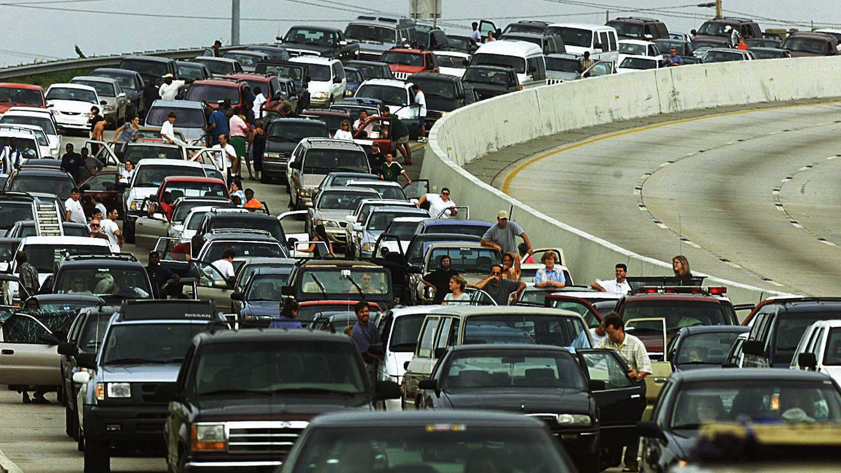
Evacuation Issues
Time - Upwards of 20 hours to Leave the State
Gas - Average Transaction $10
3 Million Not in Evacuation Zones
Lack of Hotels - Led to Overuse of Shelters
Where is it Exactly You are Going?
Notes:
Michael
Alternative to SPNS, public shelter, shelter in place
Nightmare scenario on the road
6.8 million evacuees – 1/3 of 21 million residents
Leon county filled 10 shelters with mainly people from other counties
Extremes- never evacuating vs. hell yes I’m leaving no matter the circumstances

Slide 17
Irma 2017
Satellite
Spaghetti
Notes:
Jeannette
Spaghetti- Visual representation of “where are you going”?
Not all EM’s agree on evacuation approaches
Evacuation based on storm surge- if within range safe to stay – Personal choice
The Harvey effect fearful images impact those impacted next– Irma evacuations
People stranded on their roof just 1 month before Irma.
Cascade effect
Irma Stats:
455,610 persons sheltered (General population shelters)
47,839 persons sheltered (Special Needs Shelters)
6.8 persons evacuated (about 1/3 of the state’s population)
Over 1 million meals served
Over 1 million food boxes distributed
44,803 documented volunteers served

Slide 18
Charley 9/12/04
Notes:
Jeannette
Before IRMA there was Charley in 2004 and Andrew in 1992
Transition to APD role within the states Division of Emergency Management – recap
Mitigation, preparation, response, recovery, Sheltering

Slide 19
Katrina 8/28/05
Notes:
Jeannette
That decision to stay or go has a huge impact on planning – plan for both
Katrina - true example of how storms disproportionately impact vulnerable populations

Slide 20
APD Roles
Concept of Operations Plan
Mission Essential Functions
Staff Listings
Alternative Locations (COOP)
Identifies Incident Management Team
Designated Representation at the State Emergency Operations Center (EOC)
Notes:
Karen
All agencies have a Concept of Operations Plan (similar template)
Know those that you interact with
Update at least annually – no dust!
Identify essential stuff
IMT – Incident Management Team (Logistics, Communications, Operations)
Guides what occurs before, during, and after event
People with power, no laptops.
Loss of power – huge impact

Slide 21
Information Gathering
Licensed Homes
Supported Living
Independent Living
Family Home
High Level of Information Sharing
Notes:
Karen
In order to have valid SITREP / Battle rhythm calls, large amount of intelligence gathered
Maintain Licensed home list (400+)
WSC – for each consumer they serve – with family home
Suncoast mock drill last year – training 80-90% tracked down very few sheet in Sept (IRMA)
Good Information, excellent communication let to even with no major incidents/loss of life
Types of information gathered and heard during the lifetime of an event

Slide 22
APD Emergency Operations
Daily Calls - 7 days per Week
Local, County, State, and Federal Participation
Waiver Support Coordinator Association and Partner Participation
“Unmet Needs”- Focus on Safe Shelter, Power & Water - Response & Recovery
APD has 24/7 Participation at the State Emergency Operations Center
Notes:
Karen
Tremendous level of cooperation – often cynical about government – Impressive response and cooperation
Charge phone in car- dedicated staff
Collaborate with EOC / power companies
WSC advocacy group participation
“SITREP discussed on each call focusing on unmet needs”

Slide 23
Response and Recovery Resources
Governor’s Press Releases
Floridadisaster.org
APD Website - Recovery Toolkit & Resource Directory
Everbridge
Local and State EM Communications
Shared News Releases
APD Communication
Notes:
Jeannette
Assess – Good/Bad
Access local information relevant to you

Slide 24
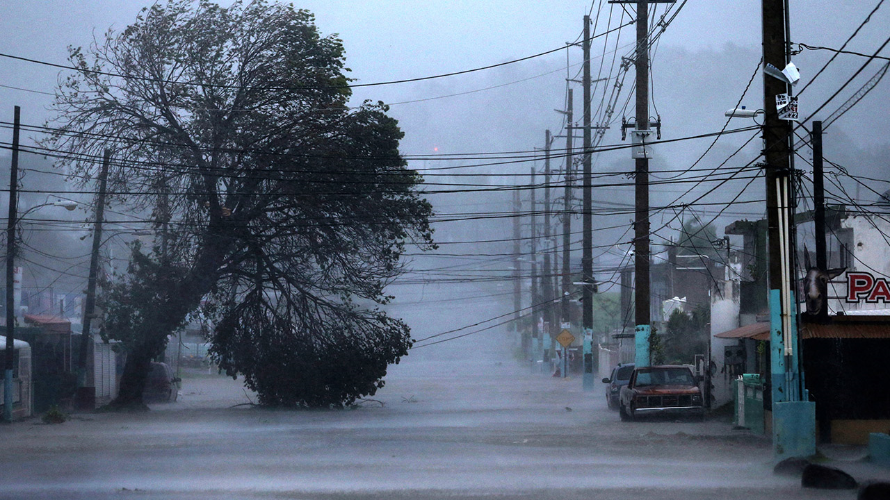
After Action
Notes:
Jeannette
Obvious Challenges (water and power)
No curfew to enforce – Inconsistent use of communication
Indicated at the beginning that more attention needed (Access and Functional Needs) – includes sensory disabilities, no English, pregnant, etc
Published after action reports – Local & State

Slide 25
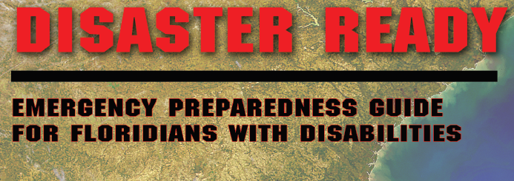
FDDC- Disaster Ready
Three Important Themes
No one-size-fits-all
Know your county
All hazards approach
Worksheets
Resources
Template for Written Emergency Plan
Notes:
Michael
Slide accompanies the Handout Booklet from FFDC
Highly Personalized
Challenges and resources
Not just hurricanes with weeks of warning- instant events
Mobility, Health, transportation, guides the planning process
Local, state, federal (phone and websites)
Can download or request hard copies of the Emergency Plans- FDDC site

Slide 26
The Plan
Living Document
Ensure Those Tasked with a Role are Aware and Remain Available
Communication Needs
Practice!
Notes:
Michael
Information overload at times.
Easy to dismiss/complacent
Revise, Revise, Revise – update condition, supports, resources
Irma – should help with good plans this year
Many templates aside from FDDC handout.
Main Resource: ready.gov; fema.gov; floridadisaster.org
Drive to find weak spots in plan

Slide 27
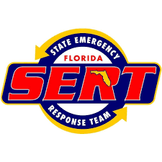
Get Involved!
CERT
SERT
Community Emergency Response Team
State Emergency Response Team
Notes:
Michael

Slide 28
Lessons Learned
Discussion
Notes:
Jeannette
What are YOUR lessons learned? (Audience?)

Slide 29
Notes:
Karen

